Slide 1
Genomic Data in a Closed World Environment
Asieh Golozar, MD PhD MPH MHS
Nemesis Health

Slide 2
Clinical care and administration
Data exchange
Longitudinal analysis
J Med Internet Res. 2024 Apr 9:26:e55779

Slide 3
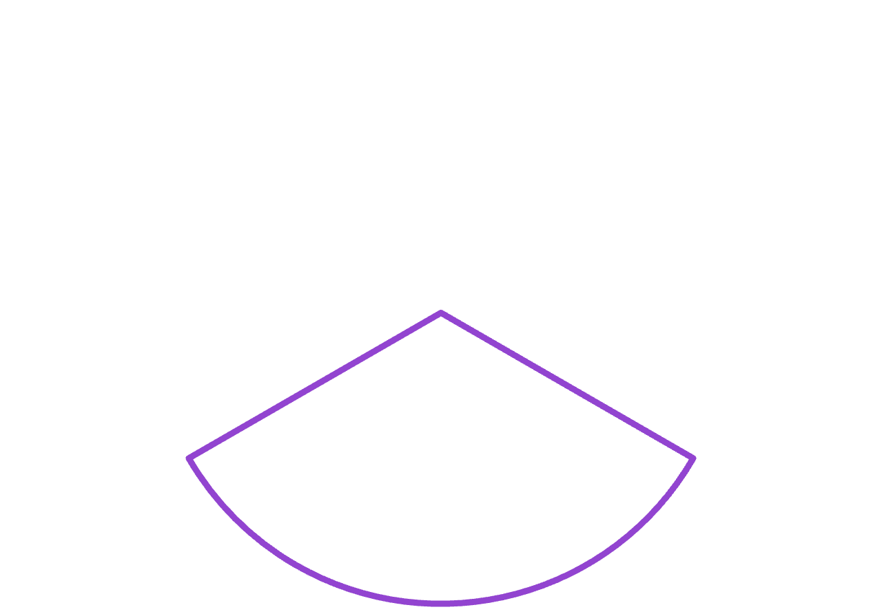






























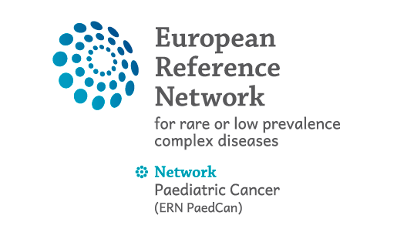





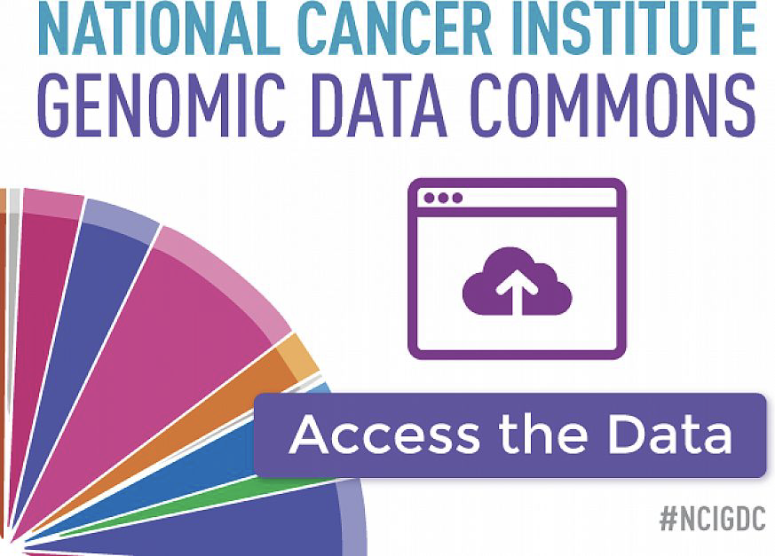












Slide 4

https://xkcd.com/927/

Slide 6
Formal logic in knowledge representation
Open-world assumption
Closed-world assumption
What we know – is true
What we don‘t know – we don‘t know
What we know – is true
What we don‘t know – is false
→ RWD is Closed World implicitly
Example:
ICD-10-CM has all diseases
Our analyses, like rates, incidence, causal effect expect, we expect:
The code if the patient suffers from it
The code to be absent if not
There is no such thing as “No MI today”.

Slide 7
Closed and Open World Domains
Closed
Conditions, including
Histology
Topology
Metastases
Lymph nodes
Stages
Grades
Drugs
Procedures
Devices
Open
Images
Wave forms
Omic variants
Locations
Survey answers
Free text

Slide 8
So, if it is not a new standard, what do we need?
Genomic Data in a Closed World Environment

Slide 9
Precision Oncology
If we ever want to apply epidemiological methods used in clinical research to the study genomic variation, it
… requires genomic variants that are:
unique,
comprehensive,
searchable,
which means, standardized
Notes:
PM is an emerging approach for disease treatment and prevention that takes into account individual variability in genes, environment, and lifestyle for each person (National Institutes of Health [NIH] 2015).
Genetic variants can be changes to sequence or structure of protein, RNA, genomic DNA or chromosomal (karyotype) level.

Slide 10
However, genomic variant data…
… are not standardized for interoperability
… are too narrow when measured through pre-defined panels and overwhelmed with meaningless information when obtained through Next Generation Sequencing
… are obtained through a myriad of different detection methods
… occur in different modalities, which are somewhat interconnected
Notes:
PM is an emerging approach for disease treatment and prevention that takes into account individual variability in genes, environment, and lifestyle for each person (National Institutes of Health [NIH] 2015).
Genetic variants can be changes to sequence or structure of protein, RNA, genomic DNA or chromosomal (karyotype) level.

Slide 11
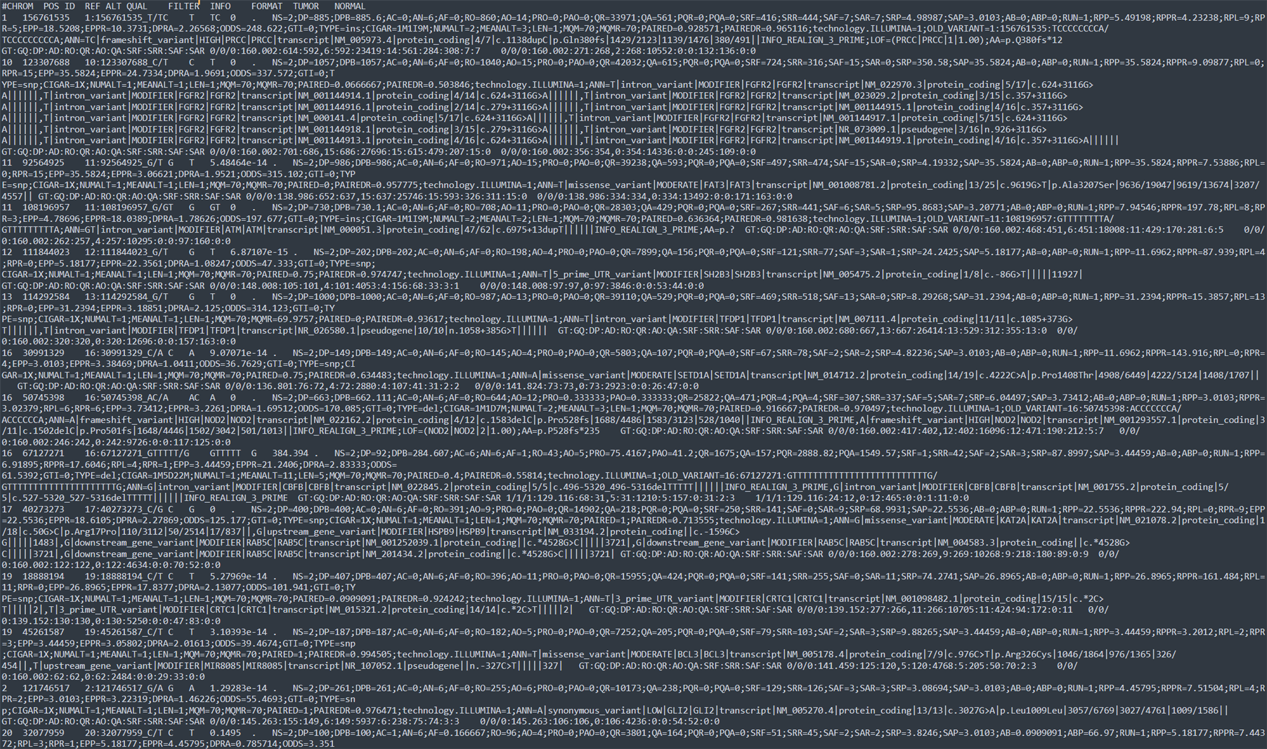
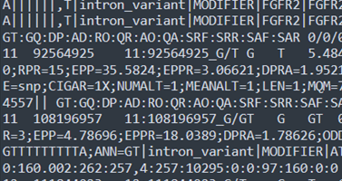
They have their own world of representation

Slide 12
They need to become features
Without features, epidemiological methods cannot work
Genomic markers need to be turned into features of an analytical dataset:
Met exon 14 skipping mutation
Splice region variant
Chromosome 7q31.2
Exon 14 missing
Location 116411884-116411895

Slide 13
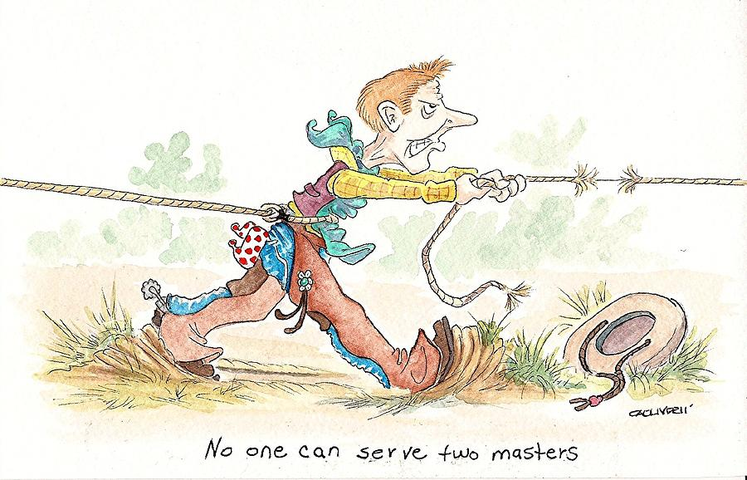
→ ETLing is easier said than done
We get:
Different modalities, which are often mixed
Different sources
Different detection methods
Flat files with complex syntax requirements but lax compliance
We need:
Precise variants
Standardized variants
Meaningful hierarchy
Closed World assumption

Slide 14
Recording Variants in the OMOP CDM

Slide 15










OMOP Genomic is built from relevant sources
… by
Combining public repositories
Deduping them
OMOP Genomic
93k coding genes
290k variants
OMOP Genomic
1128 genes
Notes:
PM is an emerging approach for disease treatment and prevention that takes into account individual variability in genes, environment, and lifestyle for each person (National Institutes of Health [NIH] 2015).
Genetic variants can be changes to sequence or structure of protein, RNA, genomic DNA or chromosomal (karyotype) level.

Slide 16
80M variants (24k tumors, 38 tumor types)
58k genes (incl pseudogenes, non-coding RNA, etc.)
All variants found (includes random variants, mutations due to age, passenger mutations)
Desired: Clinically relevant variants (driver mutations, frequent correlates, mutations relevant for drug effect)
?? Variants
?? genes
1.3k variants
681 genes
We have now
OMOP Genomic
19k coding genes
Too narrow: Established driver variants only
290k variants
OMOP Genomic
1128 genes
International Cancer Genome Consortium (ICGC)

Slide 17
OMOP Genomic contains
Genetic Variation: 19,297
Structural Variant: 3,226
Gene DNA Variant: 83,460
Gene RNA Variant: 92,988
Gene Protein Variant: 89,795
OMOP Genomic
19k coding genes
290k variants
OMOP Genomic
1128 genes

Slide 18
Hierarchical relationships inside OMOP Genomic
Logical gene
Gene variant
Is a
DNA
Structural Variant
Small DNA variant, fusion, exon
Gene amplification, deletion
Is transcribed from
Is a
RNA
Small RNA variant
RNA expression
Is translated from
Is a
Protein
Small protein variant
Protein expression
Chromosome level
Sequence mutation level
according to central dogma
Gene abundance level

Slide 19
Hierarchical relationships inside OMOP Genomic
EXAMPLE
BRAF (B-Raf proto-oncogene, serine/threonine kinase) gene variant measurement
Chromosome 7 monosomy measurement
Is a
Is a
Is a
Is a
Gene DNA Variant
BRAF::CUL1 Gene fusion measurement
BRAF on genome GRCh38 on chromosome 7 Substitution in position 140753353 of A replaced by C measurement
BRAF Gene Exon 15 Mutation measurement
BRAF Gene Amplification measurement
Is transcribed from
Is a
Gene RNA Variant
BRAF transcript: Substitution in position 1781 of A replaced by G measurement
BRAF RNA Expression measurement
Is translated from
Is a
Gene Protein Variant
BRAF protein: Substitution in position 594 Asp replaced by Gly measurement
BRAF Protein Expression measurement

Slide 20
Summary
Genomic variants must enter epidemiological research.
For that, they need to become uniquely identifiable features.
For that, we need them to be
Well, unique
Well, identifiable
Comprehensive (to cancer)
Finite
OMOP gives you all that.
Join the Journey
= Closed World

